Slide 1



Smart Irrigation System - AICTE Internship (Cycle 2)

Slide 2

Learning Objectives
✅ Understood the fundamentals of smart agriculture and how technology can solve real-world problems like water scarcity.
✅ Learned how to preprocess sensor data for machine learning models (scaling, cleaning, feature handling, etc.).
✅ Gained hands-on experience with supervised ML algorithms, including training, testing, and evaluating model performance.
✅ Built a real-time prediction interface using Streamlit, connecting frontend with backend ML models.
✅ Improved coding skills in Python, particularly with libraries like numpy, pandas, scikit-learn, and streamlit..
✅ Successfully implemented model serialization using joblib to save and reuse trained models efficiently.
GOAL

Slide 3
Tools and Technology used
CATEGORY | TOOL / TECHNOLOGY | PURPOSE / USAGE
Programming Language | Python | Core programming language used for model and logic
Data Processing | Pandas | Data manipulation and analysis
Data Processing | NumPy | Numerical operations and array handling
Machine Learning | Scikit-learn | Machine learning model training and evaluation
Machine Learning | Joblib | Saving and loading the trained model (.pkl file)
Development Environment | Jupyter Notebook | Data exploration, preprocessing, and training interface
Frontend Framework | Streamlit | Frontend web framework for creating interactive UI
Version Control | GitHub | Version control, collaboration, and project hosting

Slide 4
Methodology
Problem Understanding: Identify the issue of excessive water usage in farming due to manual irrigation systems.
Define Objectives: Set clear goals to automate sprinkler control and optimize water usage using AI.
Sensor Data Collection: Use simulated or real sensor values like moisture, temperature, humidity, etc.
Labeling the Data: Annotate the dataset with ON/OFF labels for each of the 20 sprinkler zones.
Data Cleaning: Handle missing values and remove outliers to ensure data quality.
Feature Scaling: Normalize the sensor input values to a uniform range between 0 and 1.
Model Selection: Choose an appropriate machine learning model (e.g., Random Forest) for classification.
Model Training: Train the model using the preprocessed data and evaluate its learning performance.

Slide 5
Methodology
9. Model Evaluation: Use metrics like accuracy, confusion matrix, and precision/recall to assess performance.
10. Model Serialization: Save the trained model using Joblib as Farm_Irrigation_System.pkl.
11. Frontend Development: Build an intuitive Streamlit web interface with sliders for sensor input.
12. Testing the Pipeline: Validate that the model loads correctly, processes user input, and returns accurate predictions within the UI.
13. Integration: Connect the model to the Streamlit app to enable real-time predictions.
14. Deployment: Run the system using streamlit run app.py for interactive and efficient irrigation management.

Slide 6
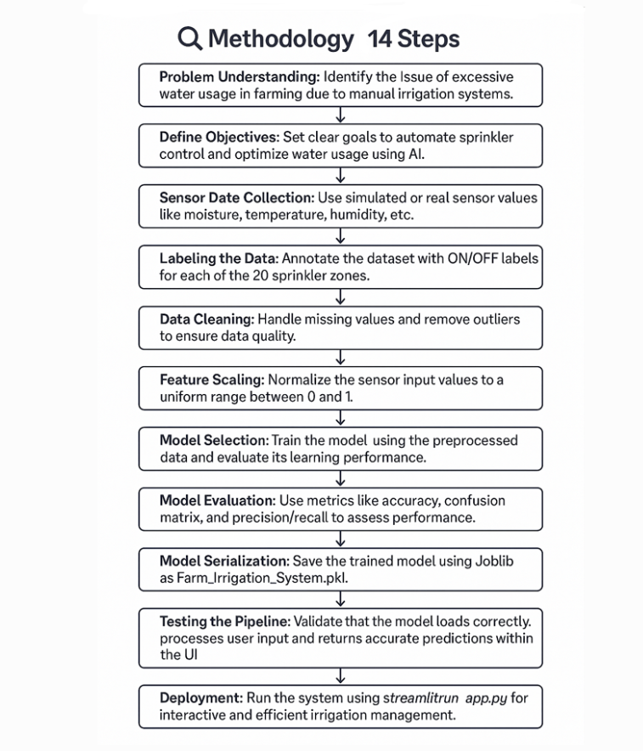
FLOW CHART FOR THE METHODOLOGY

Slide 7
Problem Statement:
🌍 1. BACKGROUND
Agriculture consumes large amounts of water.
Traditional irrigation treats all zones the same, ignoring specific crop or soil needs.
This results in over/under-irrigation and water wastage.
💧 2. TRADITIONAL IRRIGATION ISSUES
Manual Effort: Requires frequent human intervention.
Fixed Schedules: Don’t adapt to real-time soil/moisture conditions.
Wastage: Leads to excess water and energy use.
No Zonal Control: Uniform watering regardless of zone-specific needs.
🤖 3. NEED FOR SMART AUTOMATION
AI-based systems optimize water delivery zone-wise.
Use real-time sensor data for smarter decisions.
Reduces manual work and improves water efficiency.
Ensures better crop health and sustainability.

Slide 8
Solution:
1. AI-Based Automation
Develop a machine learning model (Random Forest) trained on sensor data to predict whether each of the 20 sprinkler zones should be ON or OFF.
Inputs: 20 scaled sensor values (moisture, humidity, temperature, etc.)
Outputs: 20 binary values (1 = ON, 0 = OFF)
2. Data Preprocessing
Raw sensor data is cleaned, scaled (0–1 range), and split into training and testing sets.
Feature engineering is applied to optimize model performance.
3. Model Training and Saving
A supervised machine learning model (Random Forest) is trained using the labeled dataset containing 20 sensor inputs and corresponding sprinkler zone statuses (ON/OFF).
The model learns complex patterns and decision boundaries to accurately predict which sprinkler zones require irrigation based on sensor conditions.
Once trained and evaluated for performance, the model is serialized using Joblib and saved as Farm_Irrigation_System.pkl.

Slide 9
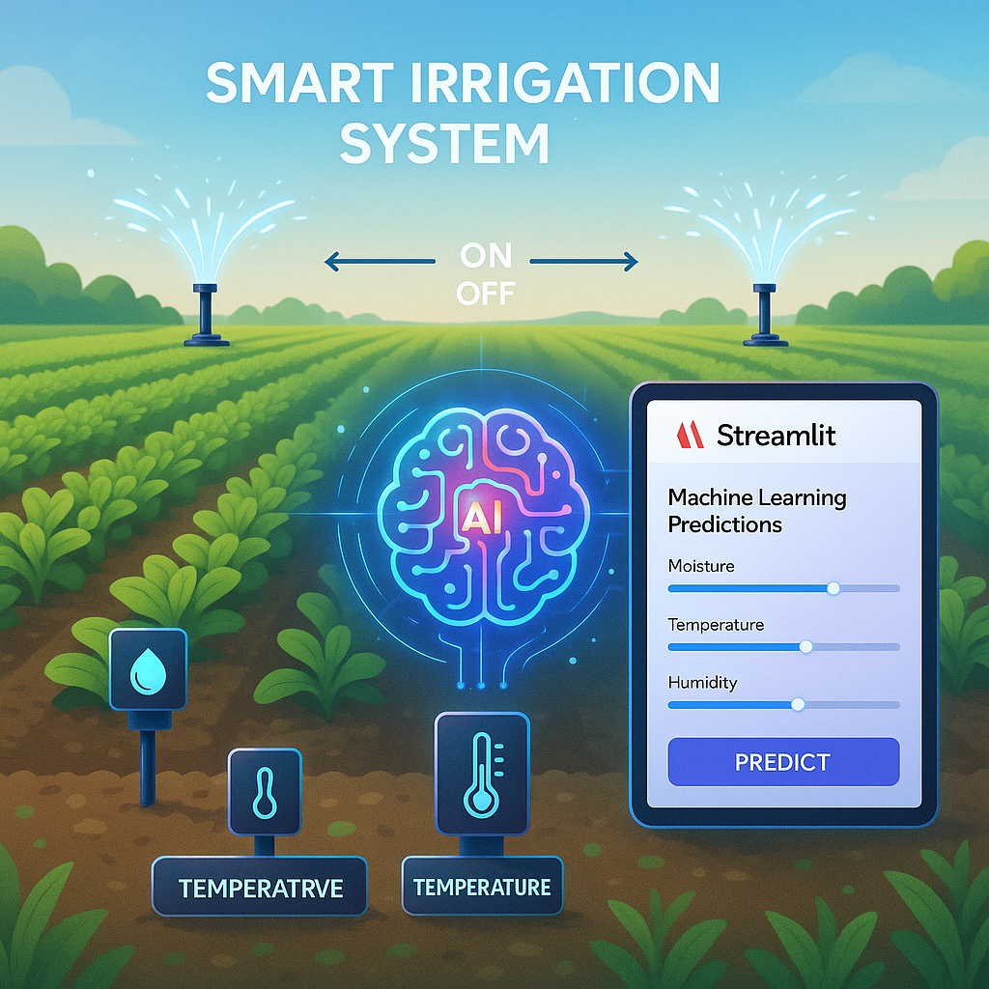
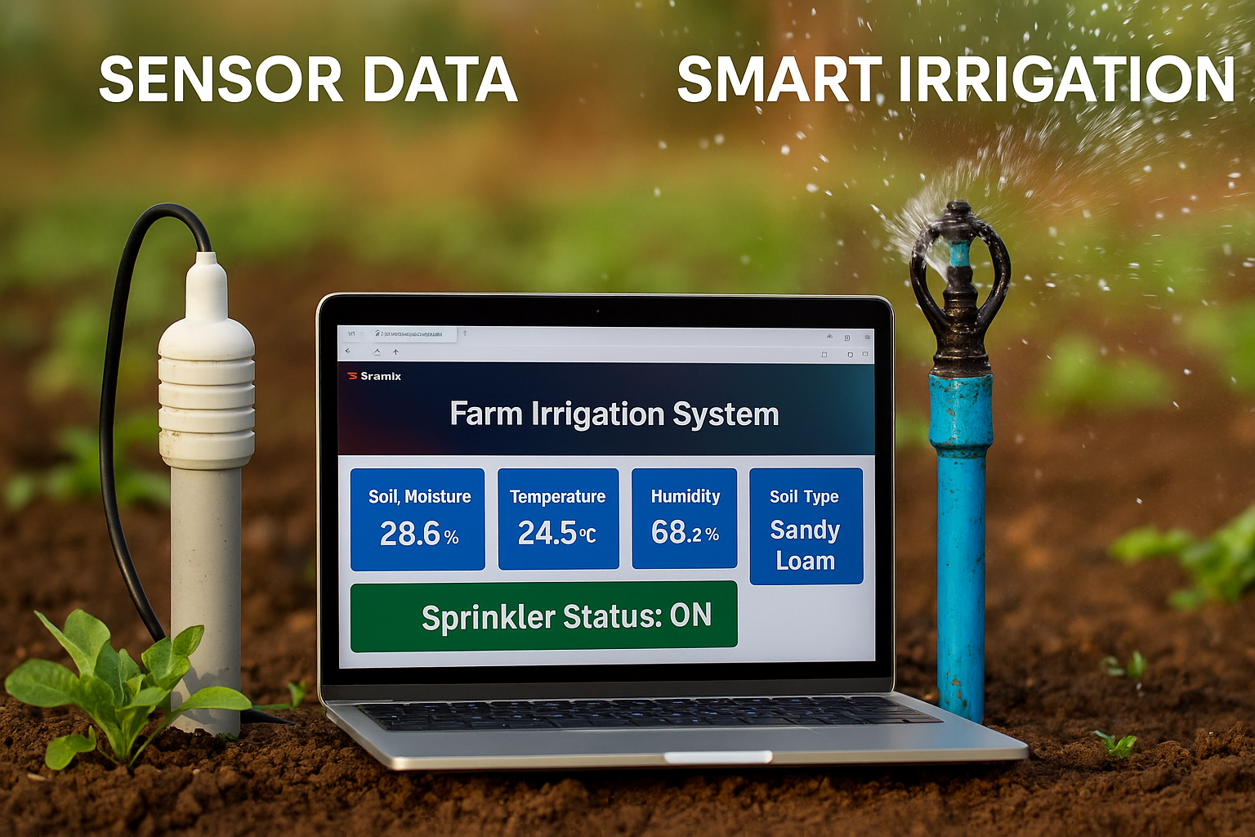
Solution:
4. User Interface with Streamlit
A simple web app (app.py) is built using Streamlit to:
Input 20 sensor values via sliders
No need for hardware during testing.
5. Impact
Automates irrigation decisions in real-time.
Supports zone-specific irrigation, reducing water and energy usage.

Slide 10
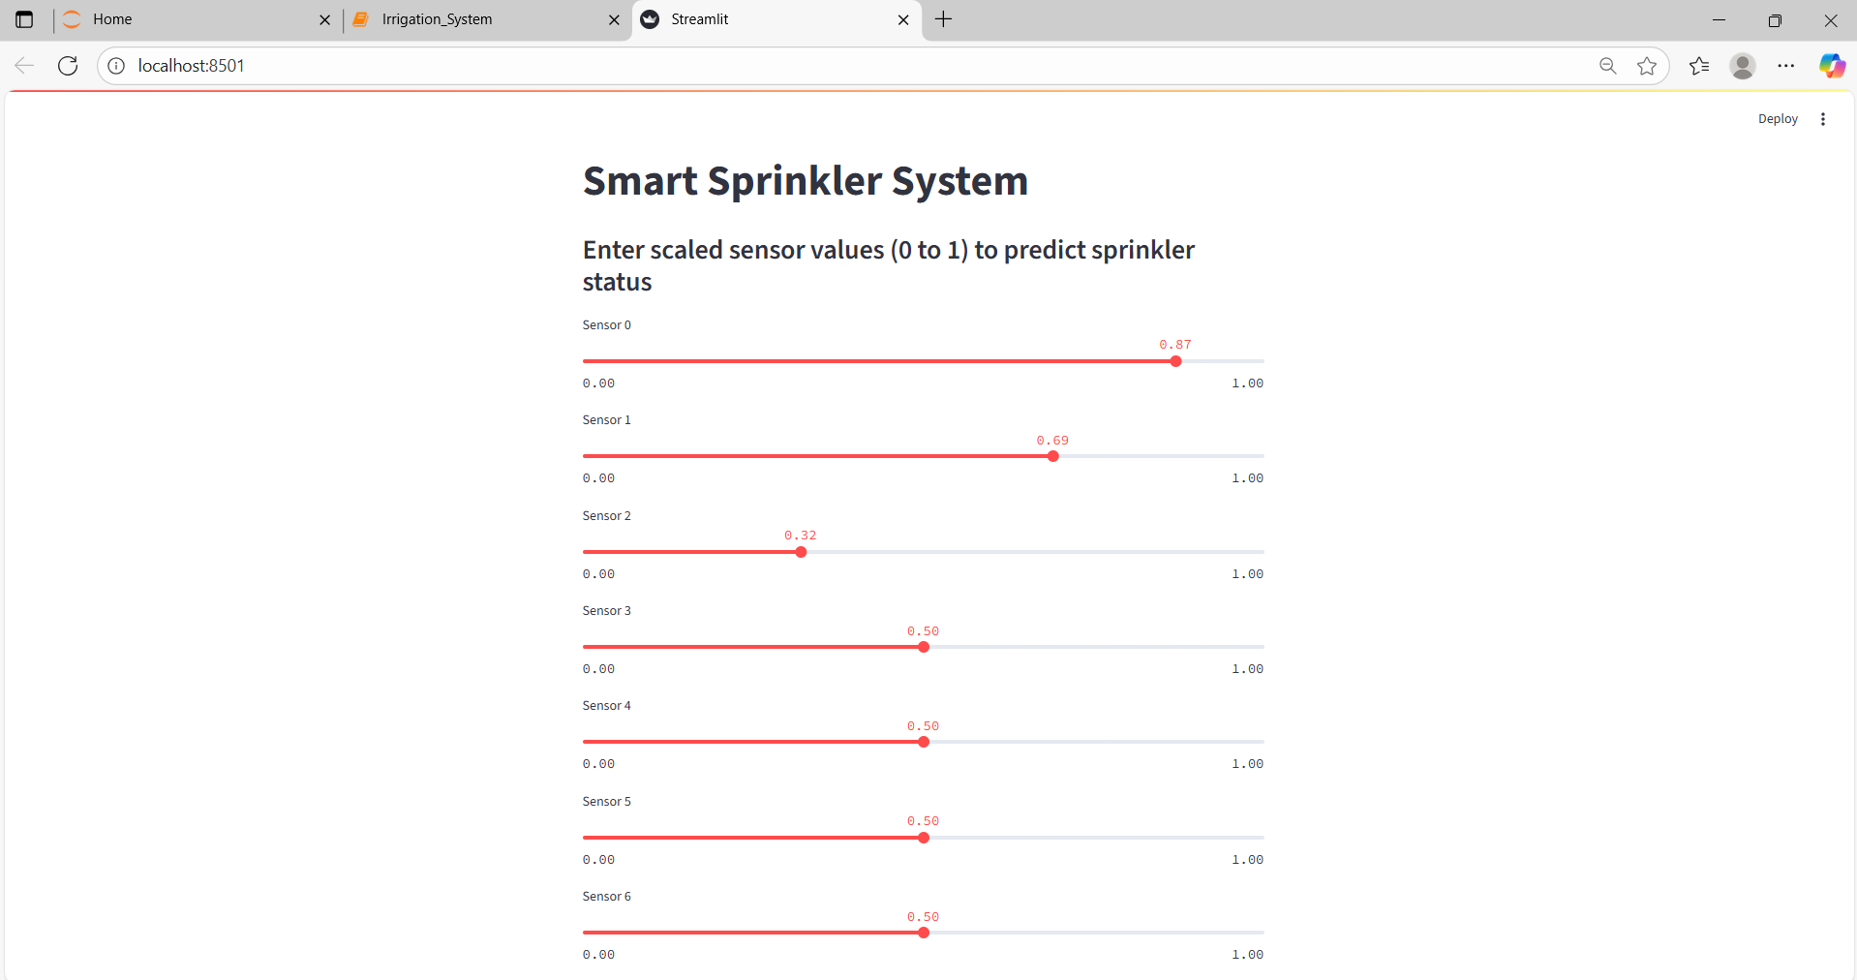
Screenshot of Output:

Slide 11
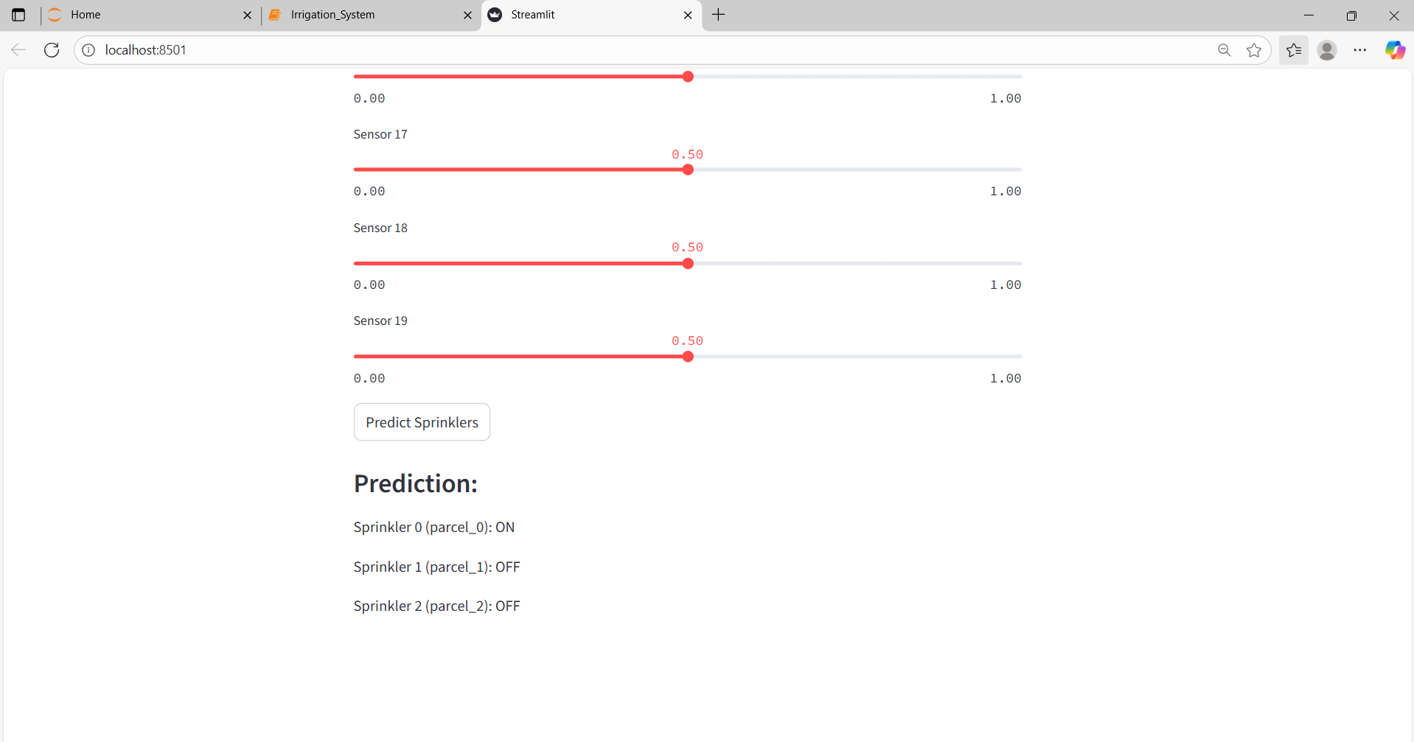
Screenshot of Output:

Slide 12
Conclusion:
The Smart Irrigation System provides an innovative solution to one of the most pressing problems in agriculture—water wastage due to manual and inefficient irrigation practices. By employing machine learning techniques and environmental sensor data, the system intelligently predicts which sprinkler zones require activation, ensuring optimal water usage while maintaining healthy crop conditions.
The project integrates a trained Random Forest model with an intuitive Streamlit web interface, allowing users to interactively input sensor values and receive real-time predictions. This user-friendly design makes it accessible for farmers and agriculture managers who may not have a technical background, thus bridging the gap between advanced technology and practical farming needs.
Looking forward, this system lays a strong foundation for future enhancements such as IoT-based automation, real-time weather adaptation, and cloud-based deployment. The Smart Irrigation System exemplifies how AI can be harnessed for sustainable agriculture, ultimately contributing to resource efficiency, cost savings, and a more resilient farming ecosystem.

